Slide 1


The Future of Sakai
Charles Severance
University of Michigan
School of Information
Longsight, Inc.

Slide 2

Disclaimer...
What I am about to talk about is not an official direction or position of the University of Michigan, Longsight, nor IMS Global.

Slide 3
Sakai Strengths
Shortest distance between end-users and core developers
Market-leading solution to teaching and collaboration for higher education
Low cost per seat (Moodle as well)
Healthy commercial provider ecosystem
Hosting flexibility (cloud in Sakai 10)
International priorities

Slide 4
Sakai Weaknesses
Sakai 2.8 (2012)
Missing critical functionality, ugly
Sakai 2.9 (2013)
Complete core "LMS" functionality, prettier
Sakai 10 (2014)
Not the market leader in "user delight"

Slide 5
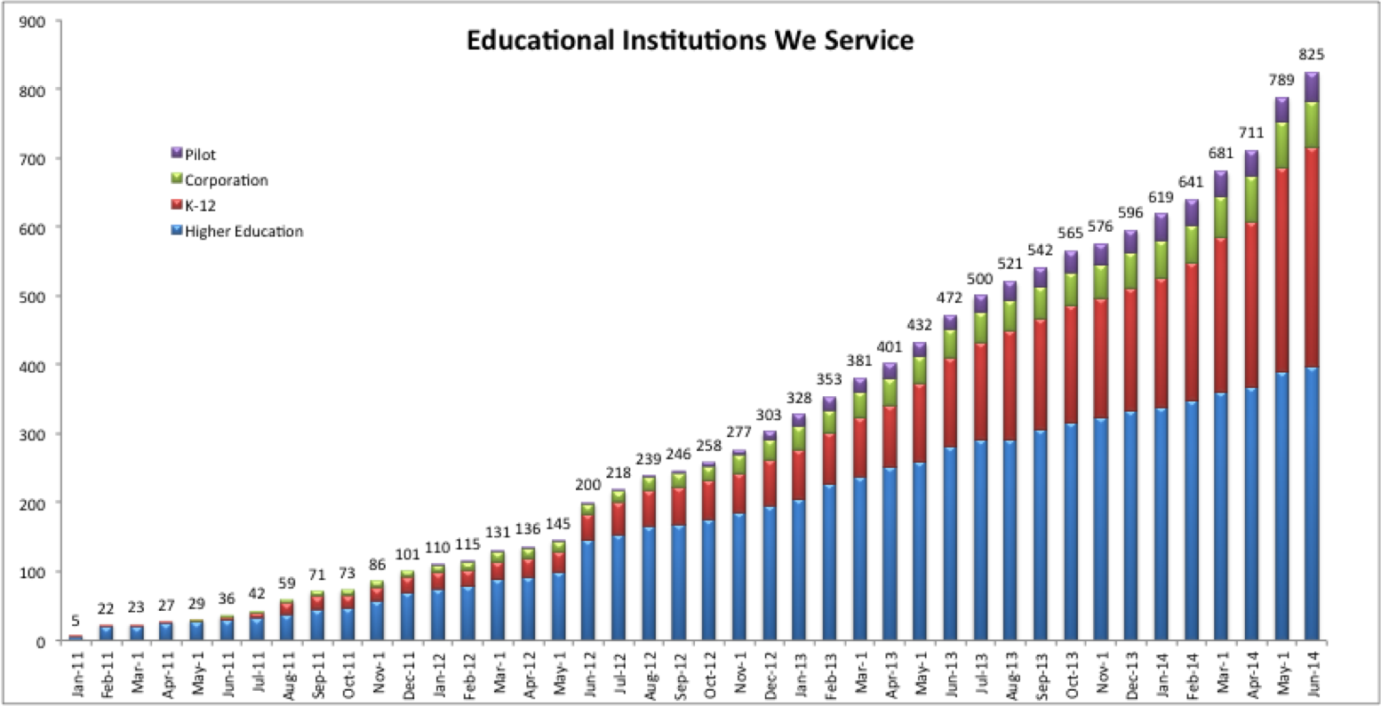

http://mfeldstein.com/instructurecon-canvas-different-competition-now/

Slide 6
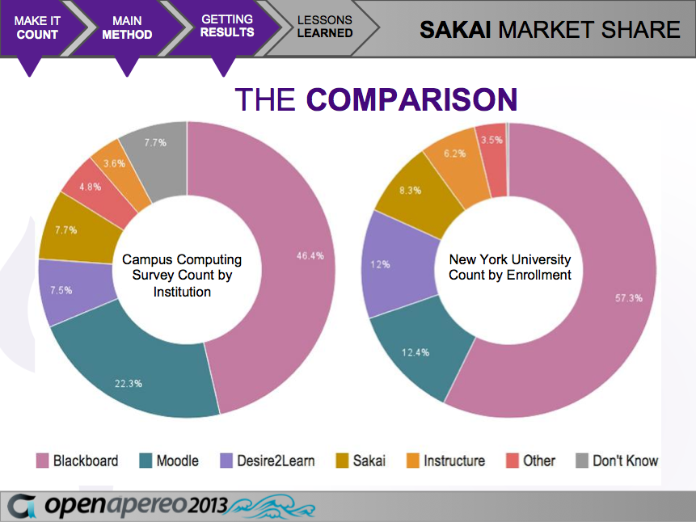
What is the Real Market Share of Sakai?, David Ackerman, Associate VP, Crystal Butler, Research Associate, New York University

Slide 7
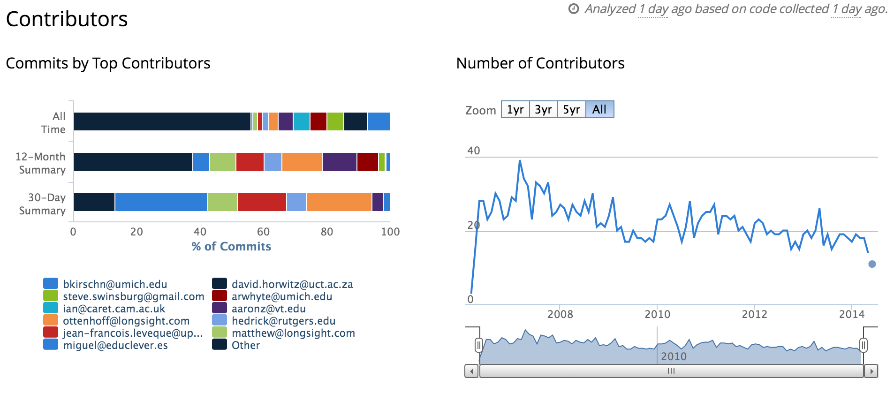
https://www.ohloh.net/p/sakai/contributors/summary

Slide 8
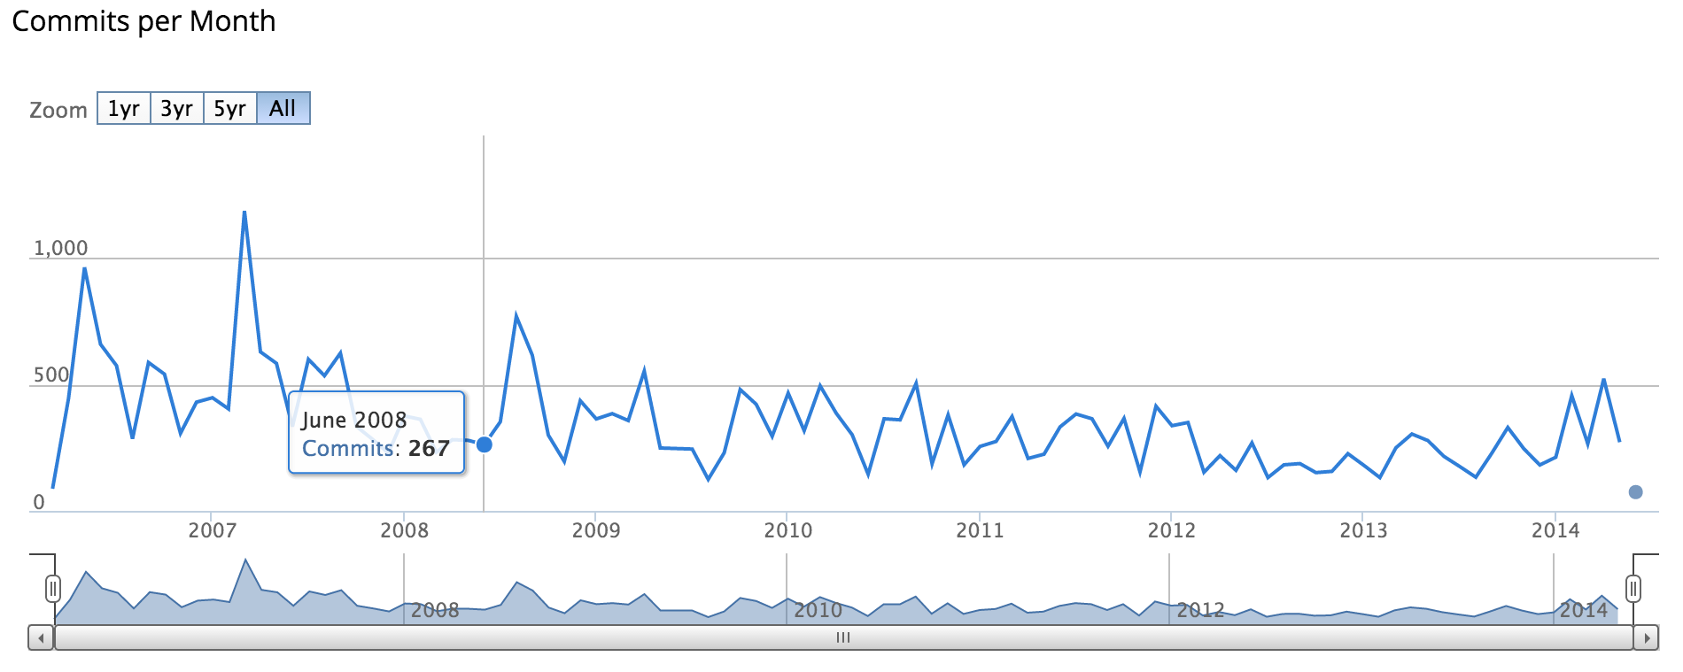
2.8
2.9
https://www.ohloh.net/p/sakai/commits/summary

Slide 9
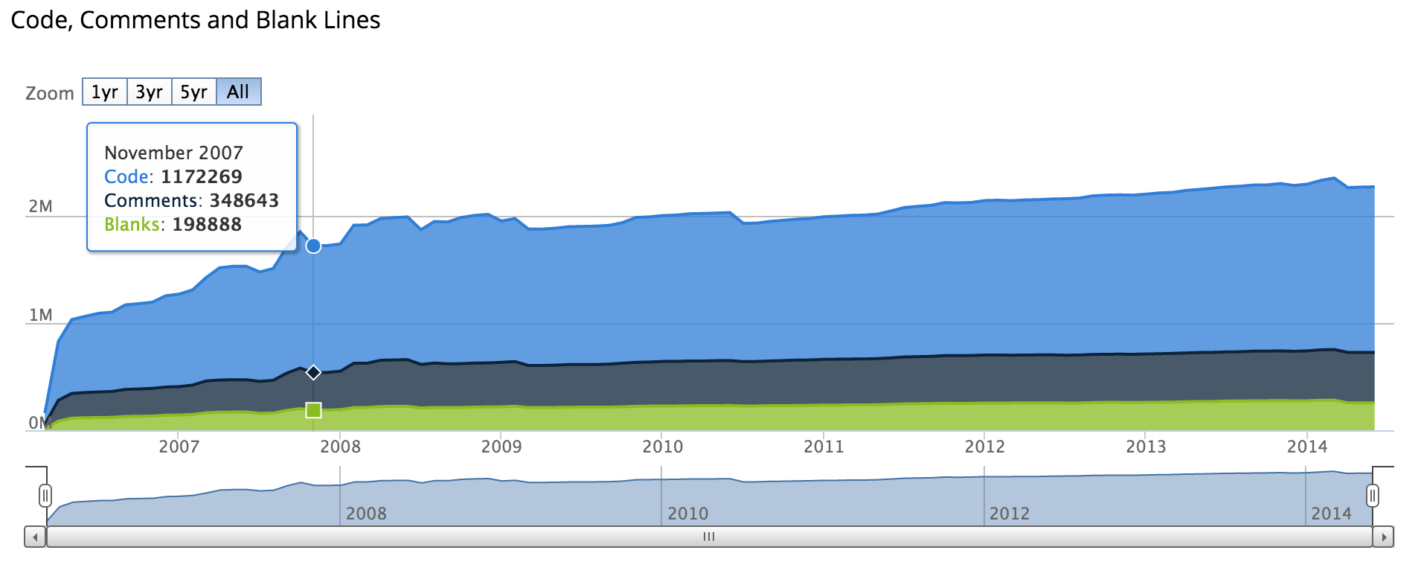
2.8
2.9
https://www.ohloh.net/p/sakai

Slide 10
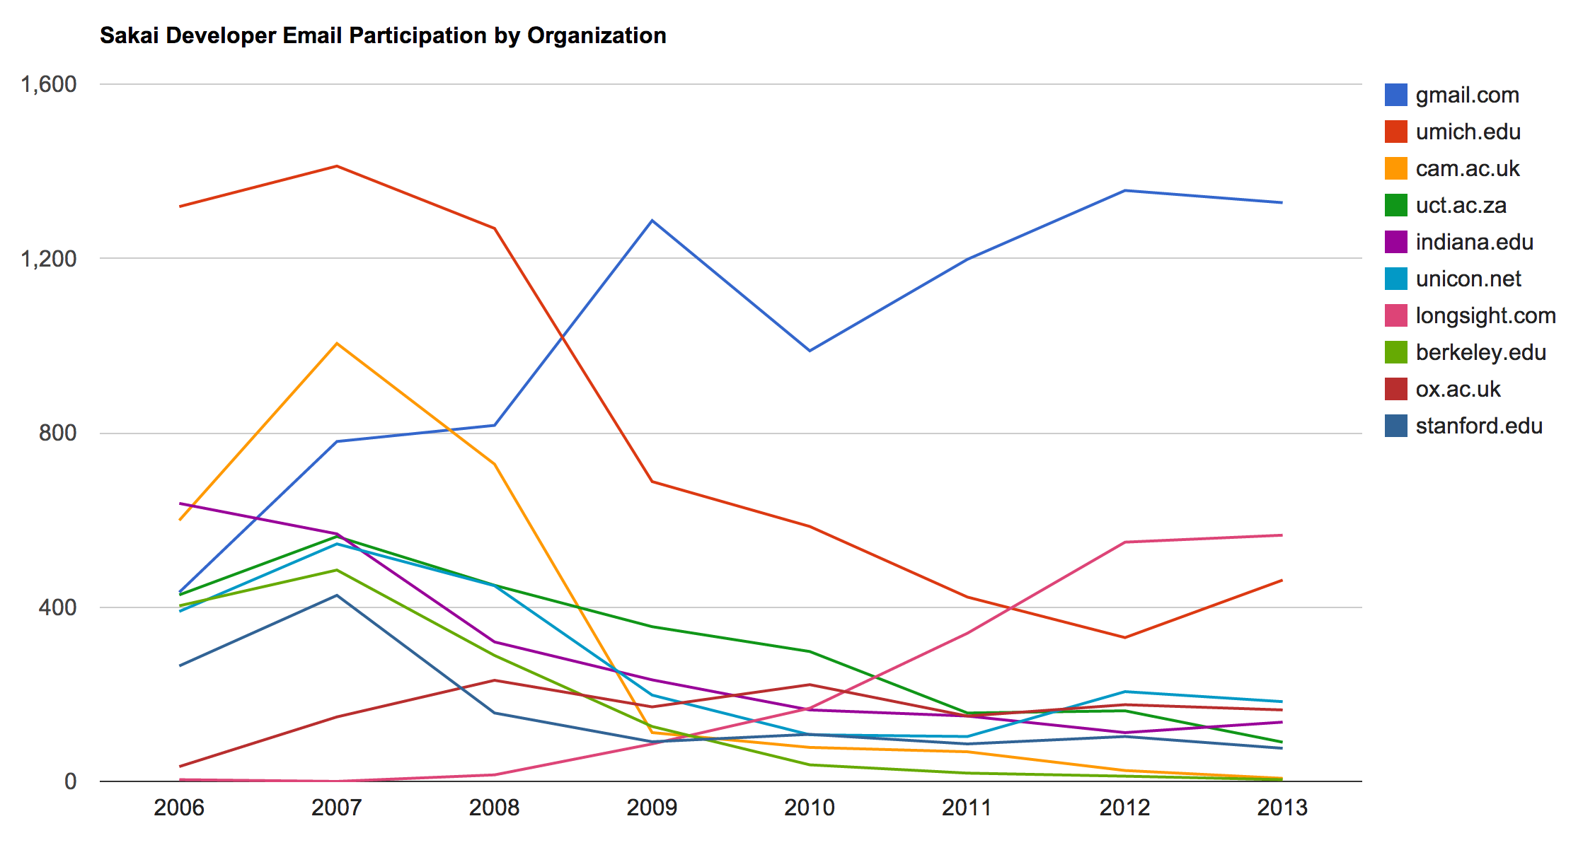
www.pythonlearn.com/book.php

Slide 11
Sakai is not Just an LMS
Still far and away the best at combining research, collaboration, and learning
Most powerful / flexible role system
Highly customizable for local needs
Real Apache-Style open source

Slide 12
Sakai 10

Slide 13
Sakai 10 User-Facing
Peer review assignments
Lessons improvement
Audio recording for RTE
Drag-and-drop uploads
Video portal chat
Improved search
Completely rebuilt help
HTML5 Audio recorder (i.e. no more Applet)
Extra credit in the grade book
Calculated question types
Assessment UI improvements
Administrator tools
http://www.longsight.com/learning-center/blog/wheres-sakai-headed

Slide 14
Sakai 10 Tech bits
Complete rewrite of site caching within Sakai
Session failover
Elastic search – within Sakai or separate server(s)
Single shared cache (Terracotta, etc)
Dynamic reconfiguration (sakai.properties)
Event delivery without using the database
Complete REST API

Slide 15
Sakai 10 "In the Cloud"
What do we mean by Cloud?
Dynamic provisioning and configuration
Lower overall resource use per active user
More suitable for virtualized environment

Slide 16

(Two-year predictions in June-2013)

Slide 17
(Two-year predictions in June-2013)

Slide 18
Sakai 11

Slide 19
To Roadmap or not to Roadmap?
Historically we have avoided extensive roadmap discussions
Unpredictable resources
Governance layers / expectations / approvals
The governance of Sakai is clear
Commercial providers resources are more consistent

Slide 20
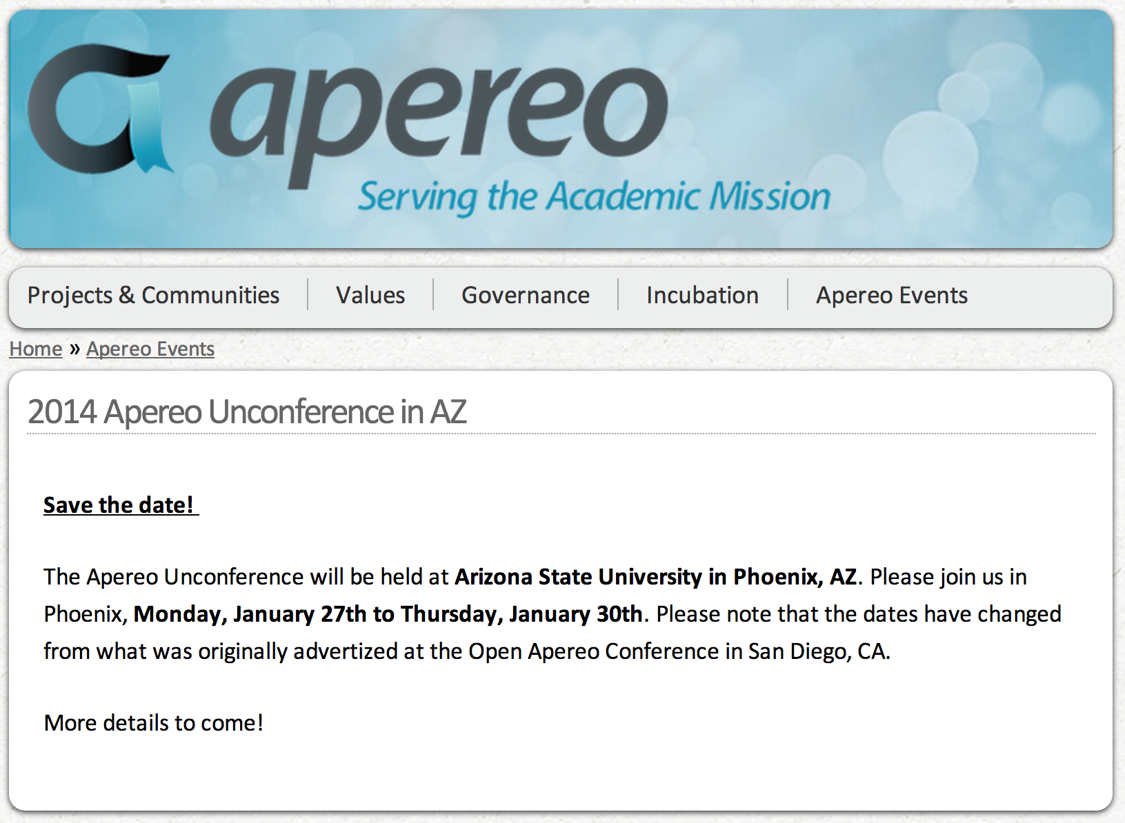
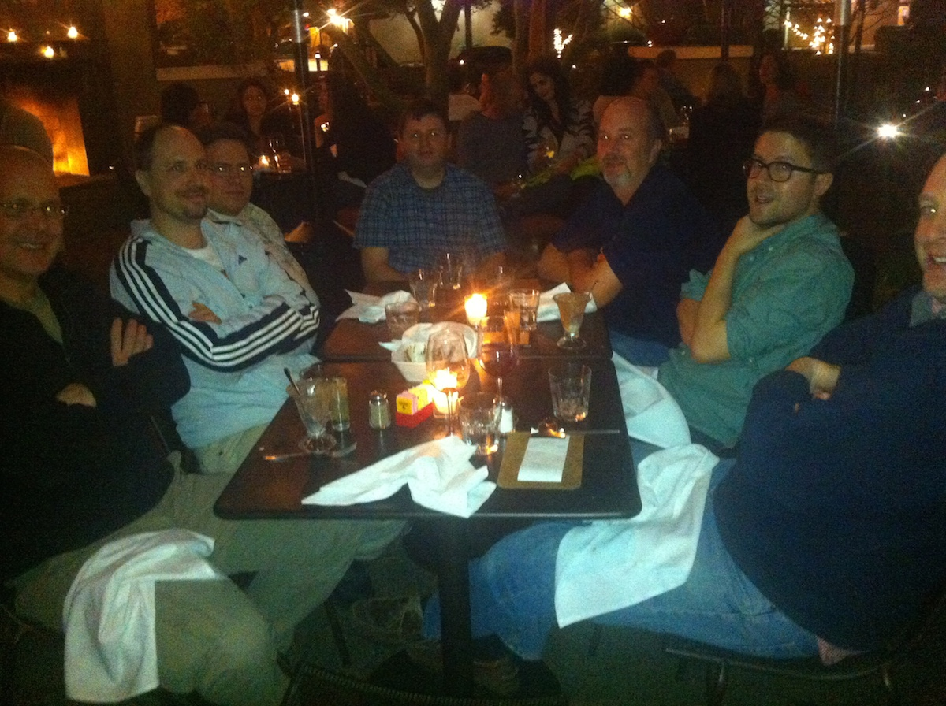

Slide 21
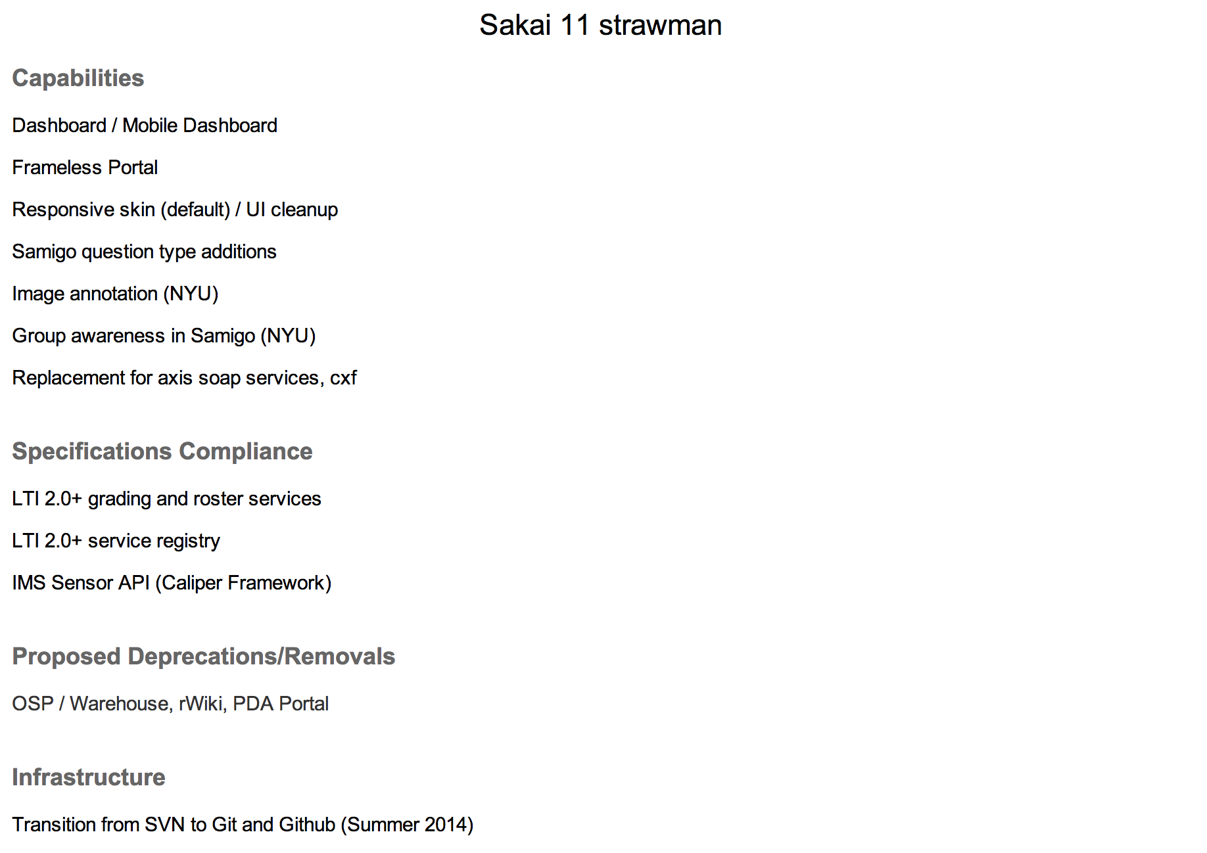
https://confluence.sakaiproject.org/display/REL/Sakai+11+straw+man

Slide 22
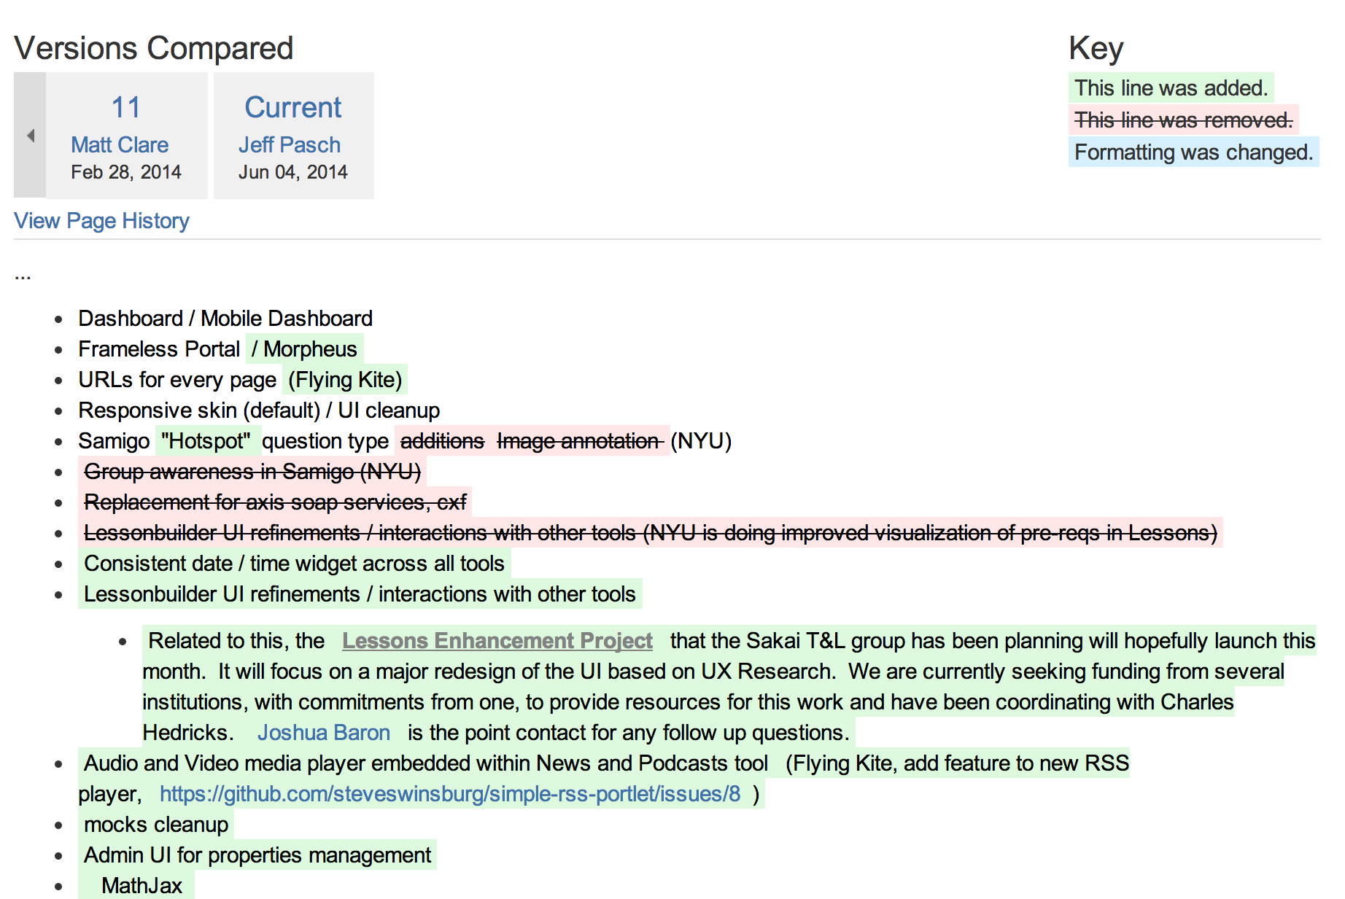
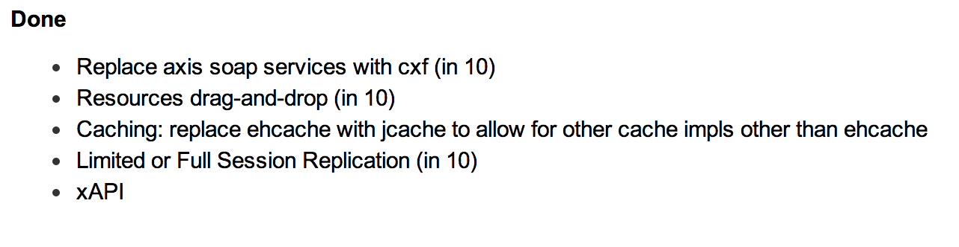
https://confluence.sakaiproject.org/display/REL/Sakai+11+straw+man

Slide 23
Sakai 11 Strawman
Dashboard / Mobile Dashboard
Frameless Portal / Responsive / Morpheus
Hotspot Question type
Lessons UI refine project (thanks to T&L group)
Admin UI for properties
SNAPP integration for discussions
https://confluence.sakaiproject.org/display/REL/Sakai+11+straw+man

Slide 24
Sakai 11
LTI 2.0+ grading and roster services
LTI 2.0 service registry
IMS CC 1.3
IMS Sensor API (Caliper)
Move from SVN to GIT
https://confluence.sakaiproject.org/display/REL/Sakai+11+straw+man

Slide 25
Stretch Goals for Sakai 11
Support LTI picker in RTE
Grade book rubrics
Grading new front end
Portfolio services to support Karuta
Google calendar
Forums tool cleanup
Forum topics embeddable
rWiki replacement
https://confluence.sakaiproject.org/display/REL/Sakai+11+straw+man

Slide 26
Beyond Sakai 11

Slide 27
http://mfeldstein.com/instructurecon-canvas-different-competition-now/
Notes:
There have been many Canvases in the past – WebCT, Angel, and MoodleRooms
Never the "enemy" – always allies of one form or another

Slide 28
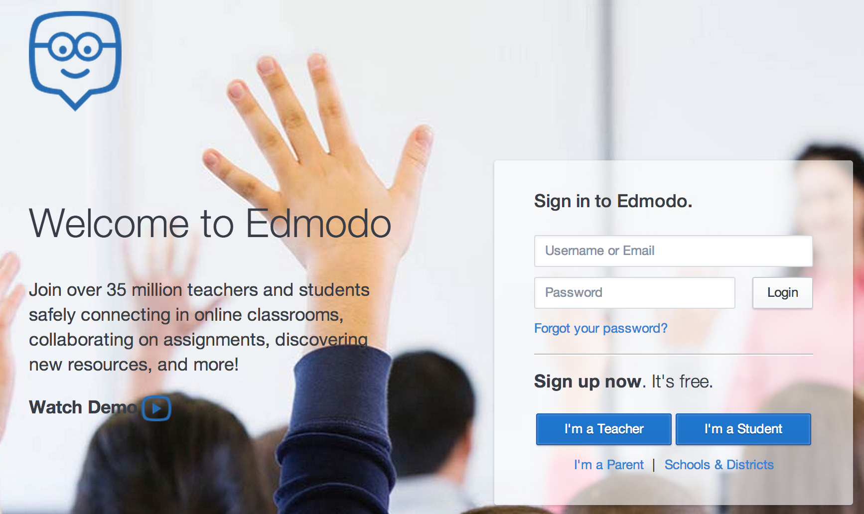

Slide 29
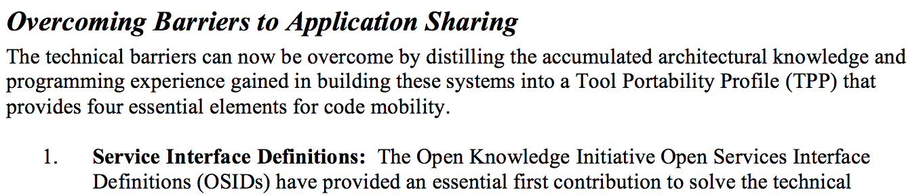
From the 2003 Sakai Proposal
http://www-personal.umich.edu/~csev/papers/2004/2004_03_01_mellon_sakai_proposal.pdf

Slide 30
A Decade of Leadership
Sakai 10 is a world-class Enterprise LMS
We have been a driving force in building standards and interoperability in LMS systems
IMS Learning Tools Interoperability
IMS Common Cartridge
We have made the market better and safer
Notes:
We are still here – we lead the market – folks like Canvas take our best ideas and implement them – great. That is part of being the leader.

Slide 31







"Large Midwestern University"
Sakai
.......
Sakai has changed the world.... But...

Slide 32

Bundling the LMS
To date, the dominant strategy in the LMS marketplace has been:
Push as much into the LMS as possible
Fight to gain market share
Get to the tipping point and eliminate the competitors
This means every 3-4 years a new well-funded "invading army" shows up
Teachers, students, and IT staff are "prisoners of war"
http://blogs.hbr.org/2014/06/how-to-succeed-in-business-by-bundling-and-unbundling/

Slide 33
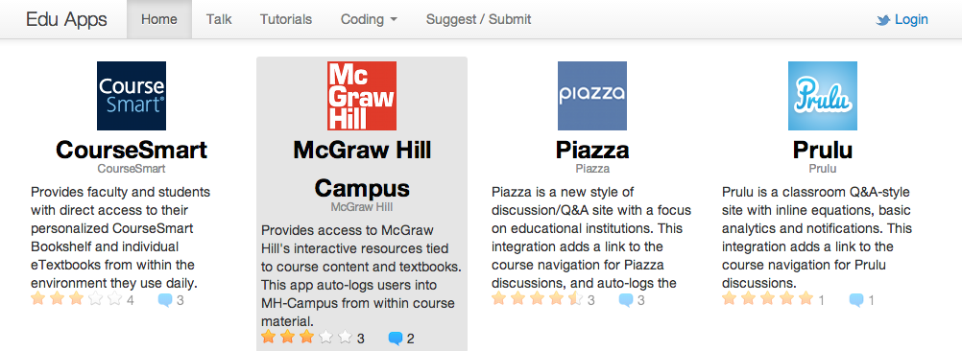
Un-Bundling the LMS
Multiple cooperating vendors in an ecosystem together
Building hundreds of applications that work with any LMS
Free teachers and local IT staff to innovate

Slide 34

The Standards are Coming...
LTI 1.x – Three pages of spec and some "hello world" code
LTI 2.x – Several specs – multiple interactions
We will need to share common implementations across instructions
And what about Caliper, Casa, xAPI, etc. ??

Slide 35



An Architecture for Unbundling...
App
Store
Tool
Tool
Tool
Tool
...

Slide 36
An Architecture for Unbundling...
Tsugi
Hosting
Container
Tool
Tool
Tool
Install
App
Store
Tool
Tool
Tool
Tool
...

Slide 37
An Architecture for Unbundling...
Tsugi
Prod
Tsugi
Exp
Tool
Tool
Tool
App
Store
Tool
Tool
Tool
Tool
...

Slide 38
CALIPER proof-of-concept
Summer 2014
Caliper
context
LTI app
video
2
LMS
LTI launch
sensor
Course
1
renderer
embedded
launch
LTI launch
ePub
Embedded app
quiz
sensor
3
Caliper
context
Caliper
context
sensor
sensor
dashboard
LTI launch
Caliper
context
LTI app
2
quiz
4
sensor
Caliper endpoint
Notes:
POC LTI chaining scenario
Coalition of the willing

Slide 39
Unbundled Apereo Projects
Learning Analytics Initiative
Working with the Society for Learning Analytics (SOLAR)
Karuta – Portfolio System
TSUGI – External Tool Hosting Environment
Working with IMS Global Learning Consortium
These will be cross-LMS projects

Slide 40








Crazy Future

Slide 41
Questions...

